Slide 1
Predicting with Bank Marketing Data
Prepared by: Austin Lim

Slide 2
Goal
Determine which clients will be receptive to our campaign
Evaluate Existing Prediction Model

Slide 3
Agenda
Data Variables Explanation
Data Cleaning
AUPRC Introduction
Current Model Evaluation
Benchmark for New Model
New Model: Random Forest
Business Insights

Slide 4
Data Variables
Client Information:
Age
Job
Marital Status
Education
Has Credit in Default?
Has Housing Loan?
Has Personal Loan?

Slide 5
Data Variables
Campaign Information:
Contact Communication Type
Month
Day of Week
Contact Duration
Number of Contacts Performed During This Campaign
Number of Contacts Performed Before This Campaign
Outcome of Previous Campaign (Poutcome)
Days passed since last campaign (Pday)

Slide 6
Data Variables
Social and Economic Information:
Employment Variation Rate
CPI: Consumer Price Index
Euribor 3 Month Rate
Number of Employees

Slide 7
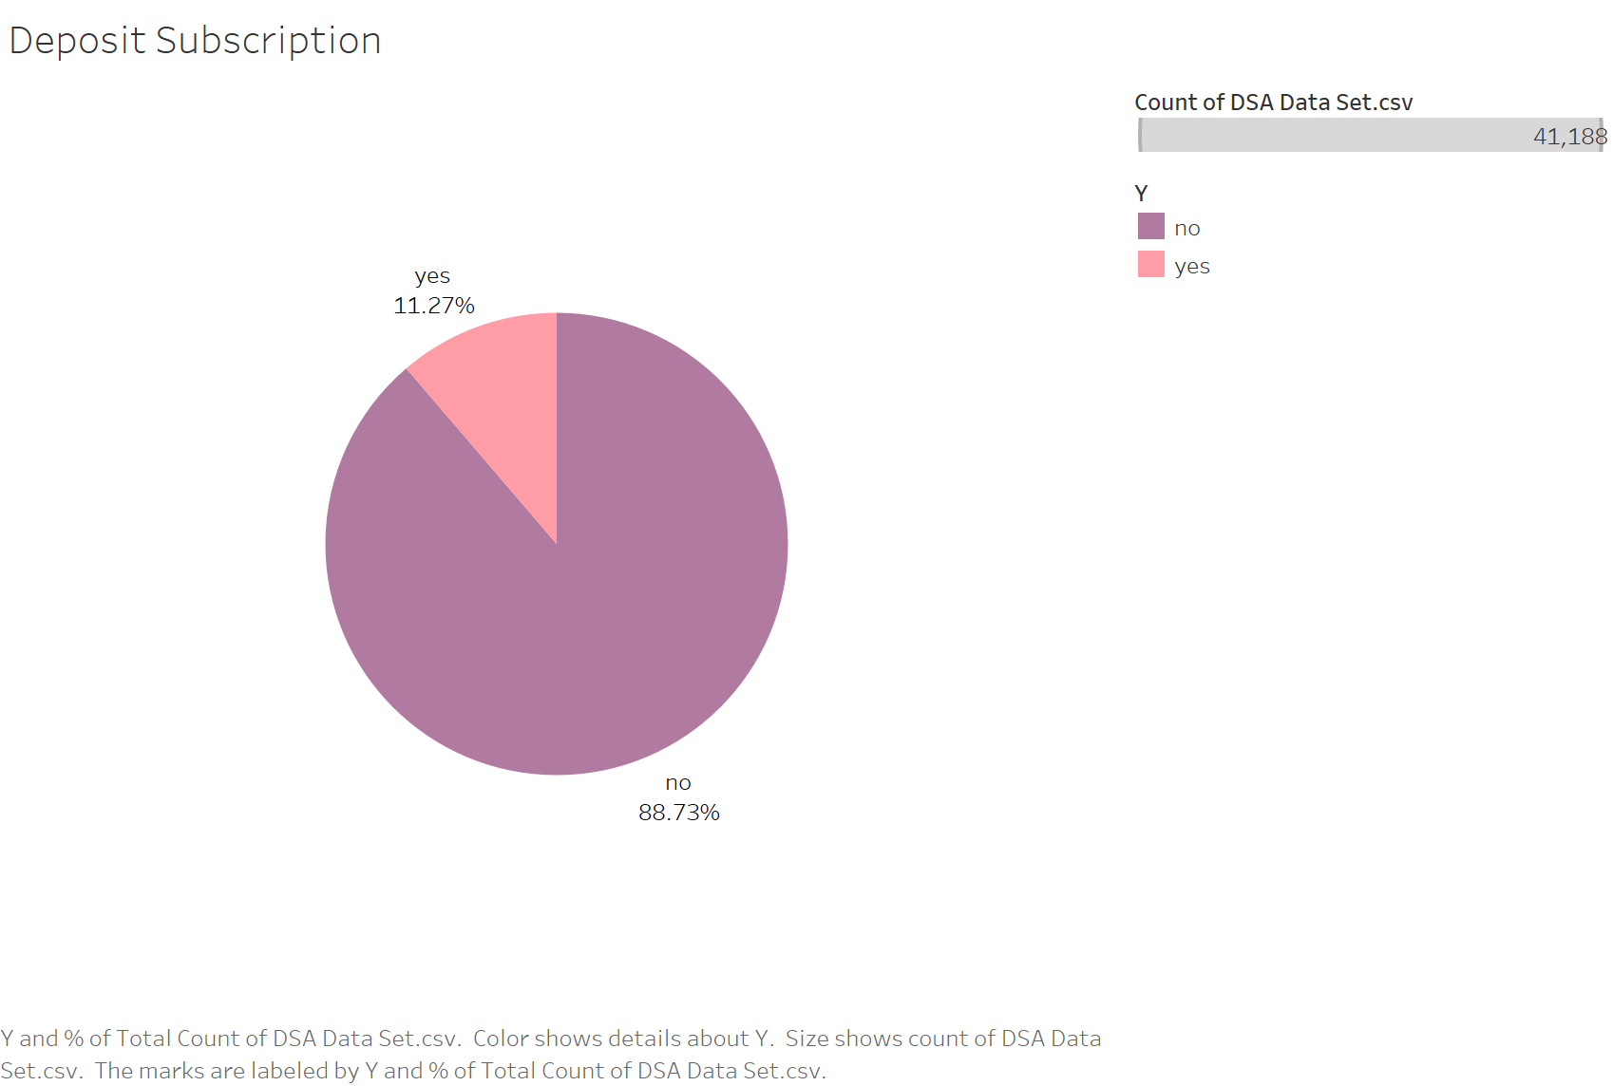

Slide 8
Data Cleaning:
Remove NAs (Unknown Values)
Changing Variable Formats
Splitting Data (Training 70%, Valid 30%)

Slide 9
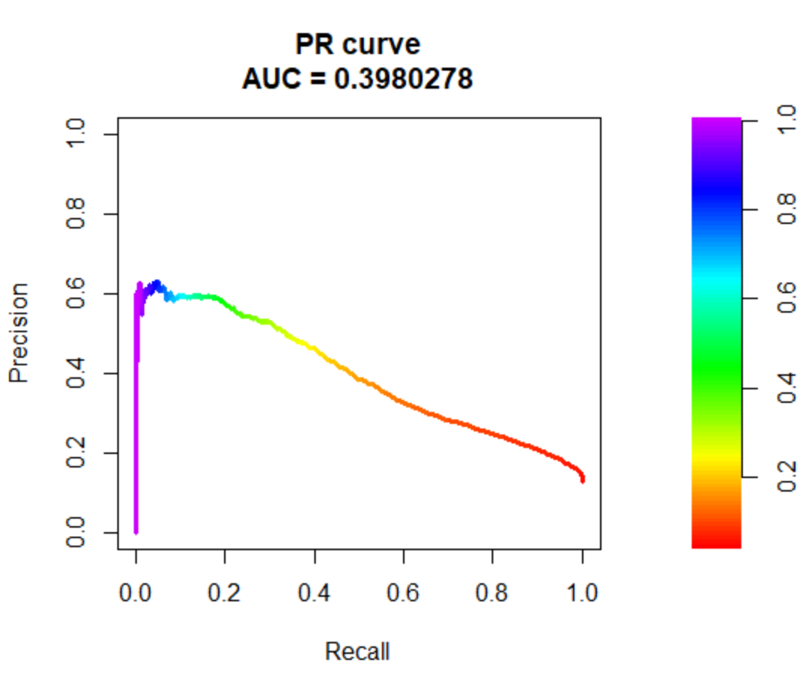
AUPRC – Area Under Precision Recall Curve

Slide 10
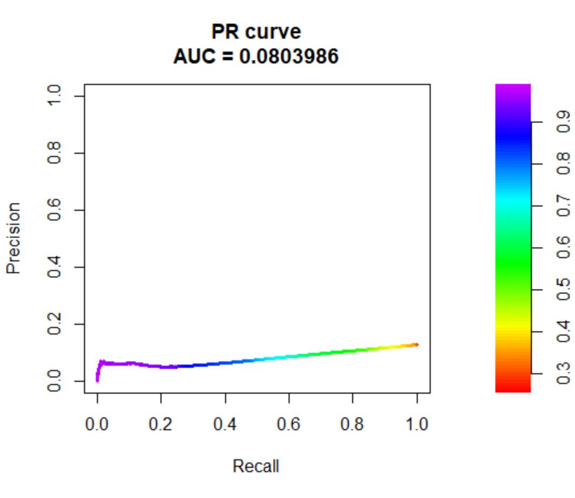

Current Model Evaluation
Training:
Valid:

Slide 11
Benchmark for New Model:
Logit Model: Use Duration as the only independent variable for prediction

Slide 12
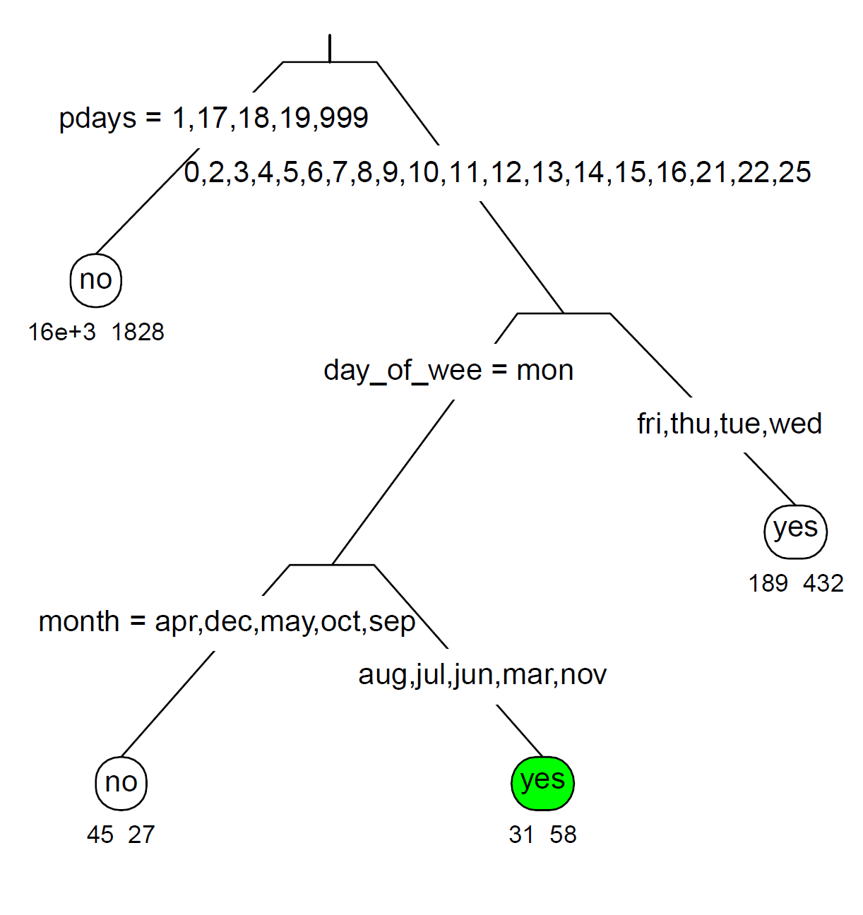
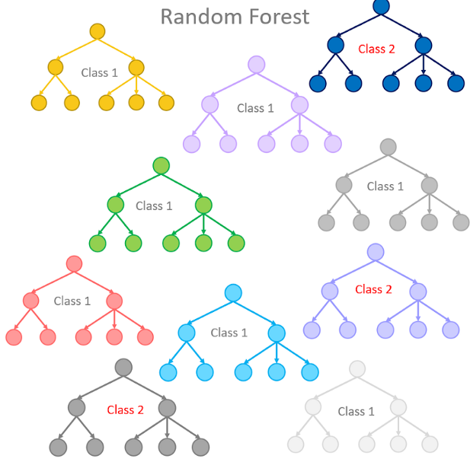
New Model: Random Forest

Slide 13
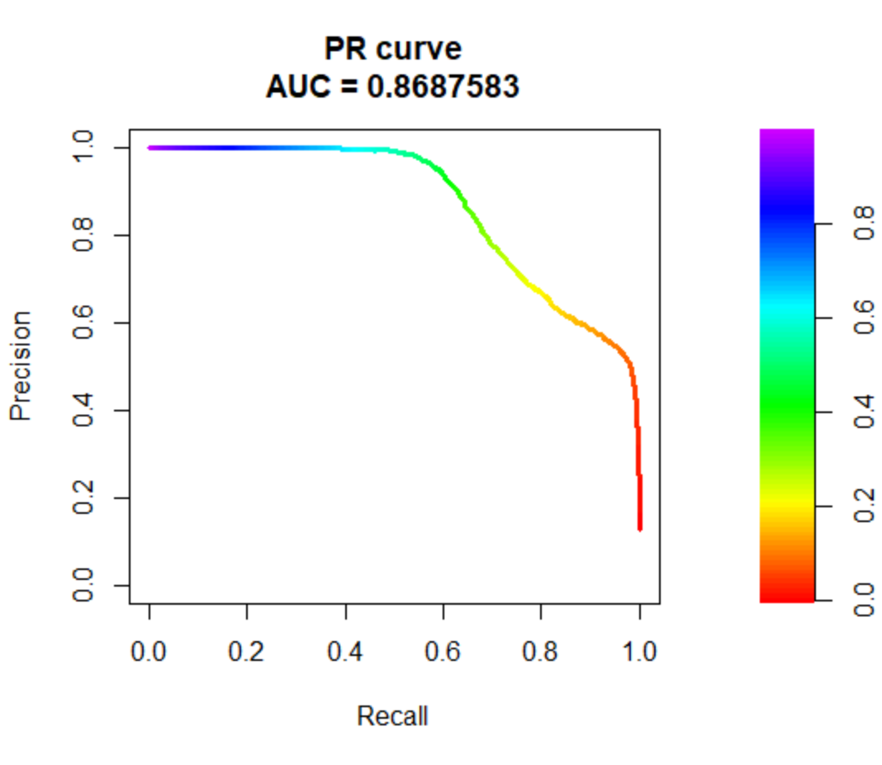
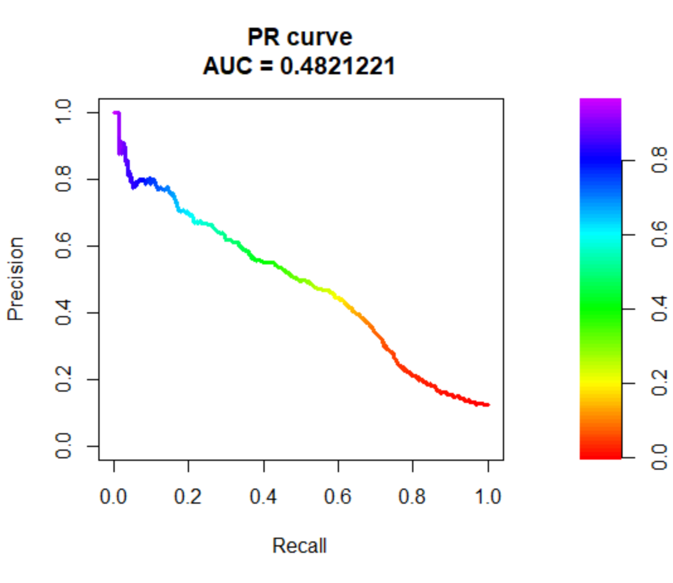
Random Forest Performance
Training:
Valid:

Slide 14
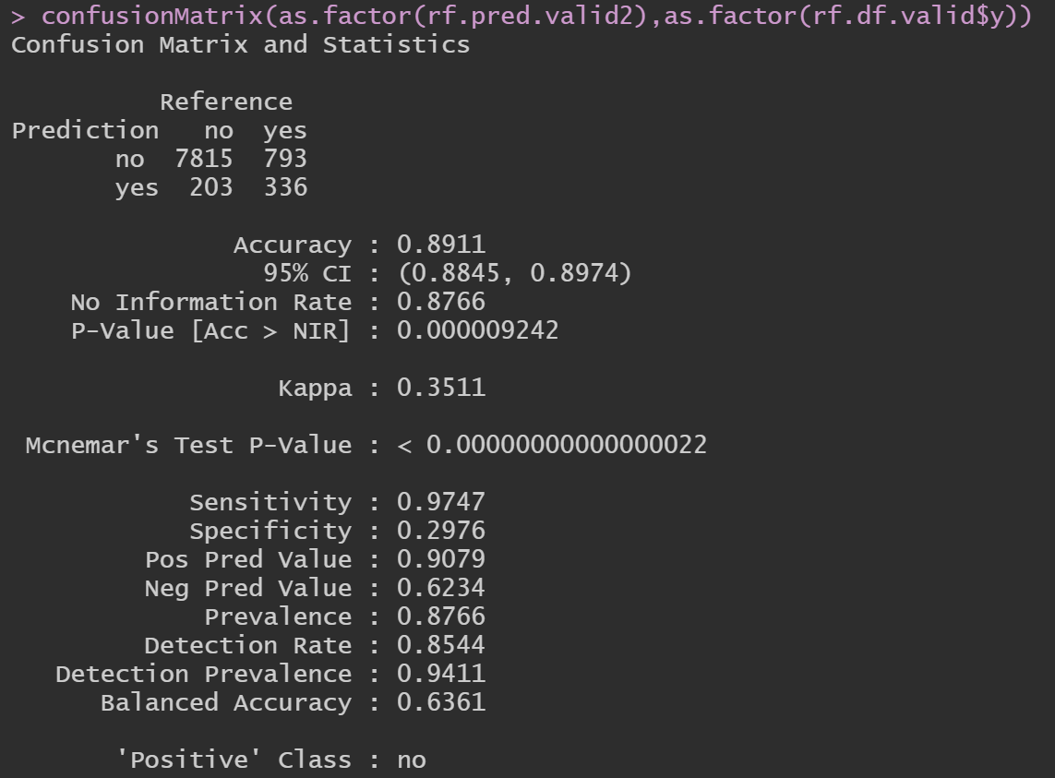
Let’s try with threshold = 0.5
Recall: 0.9747
Precision: 0.6234

Slide 15
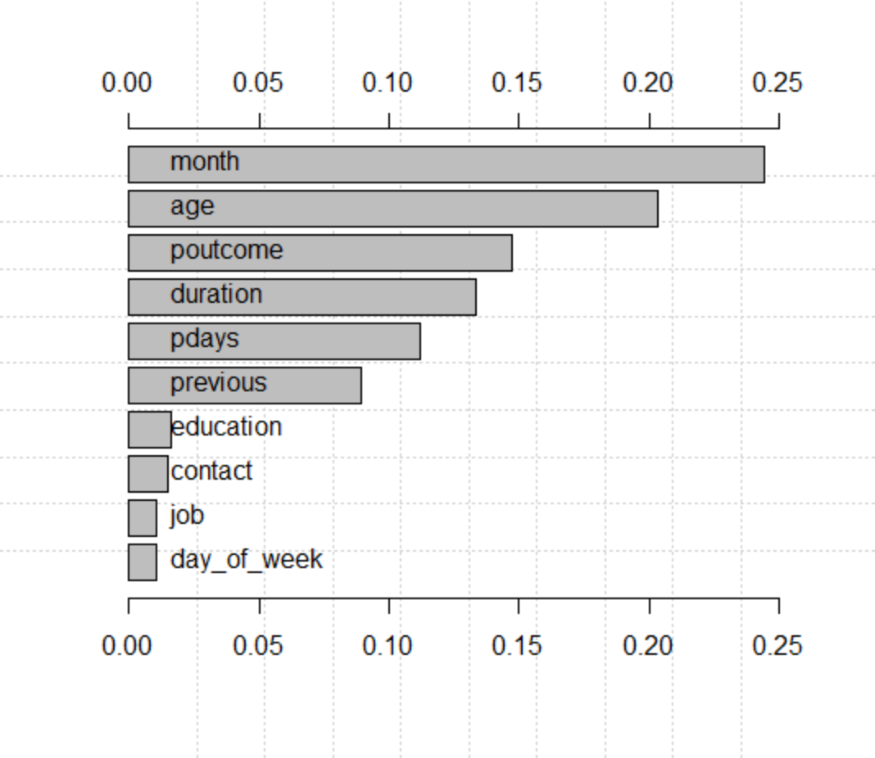
Business Insights: Feature Importance

Slide 16
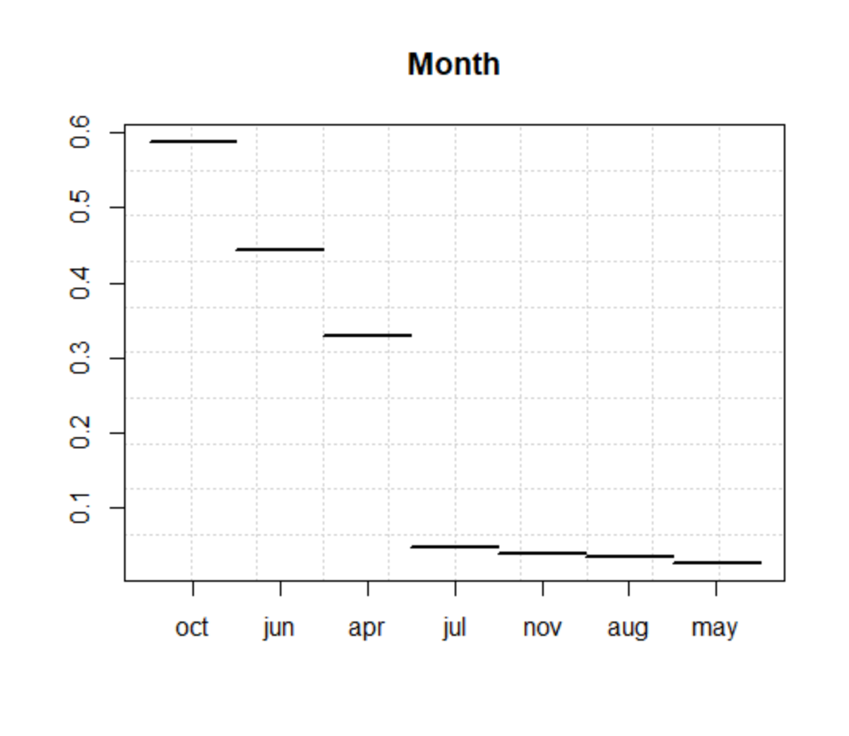
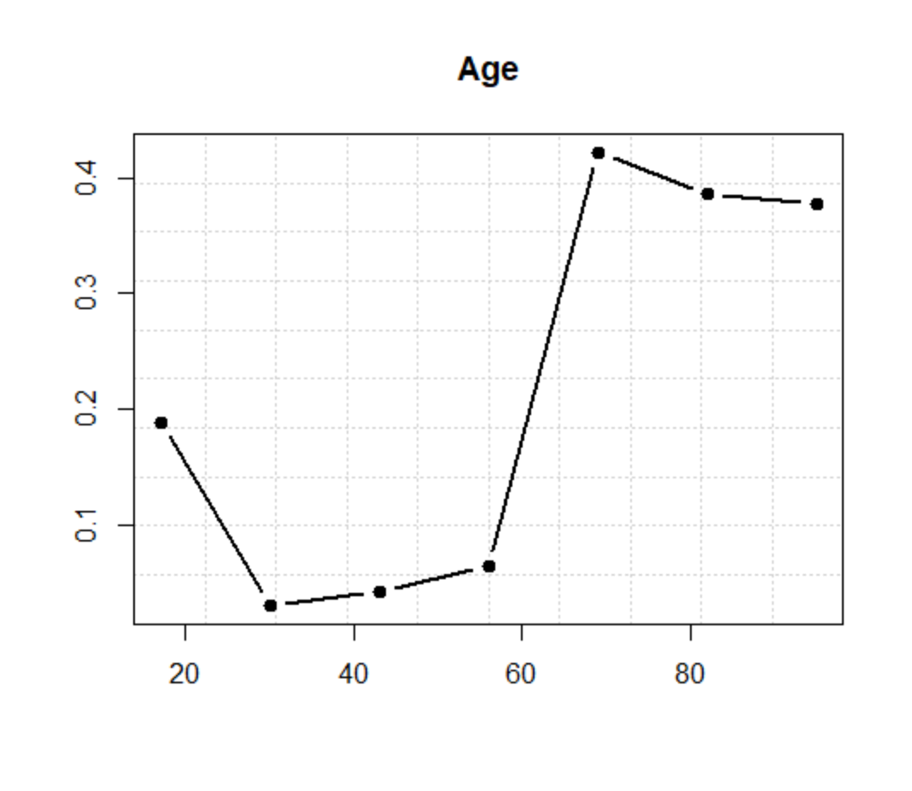
Sensitivity Analysis:

Slide 17
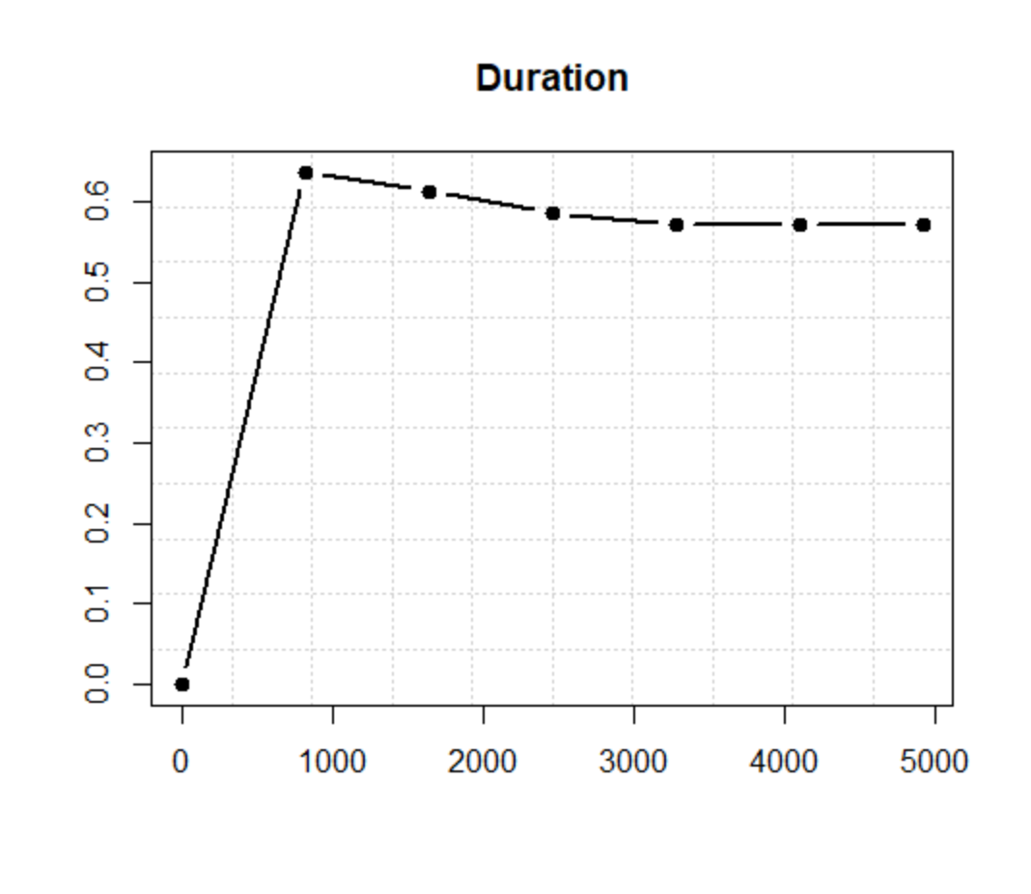
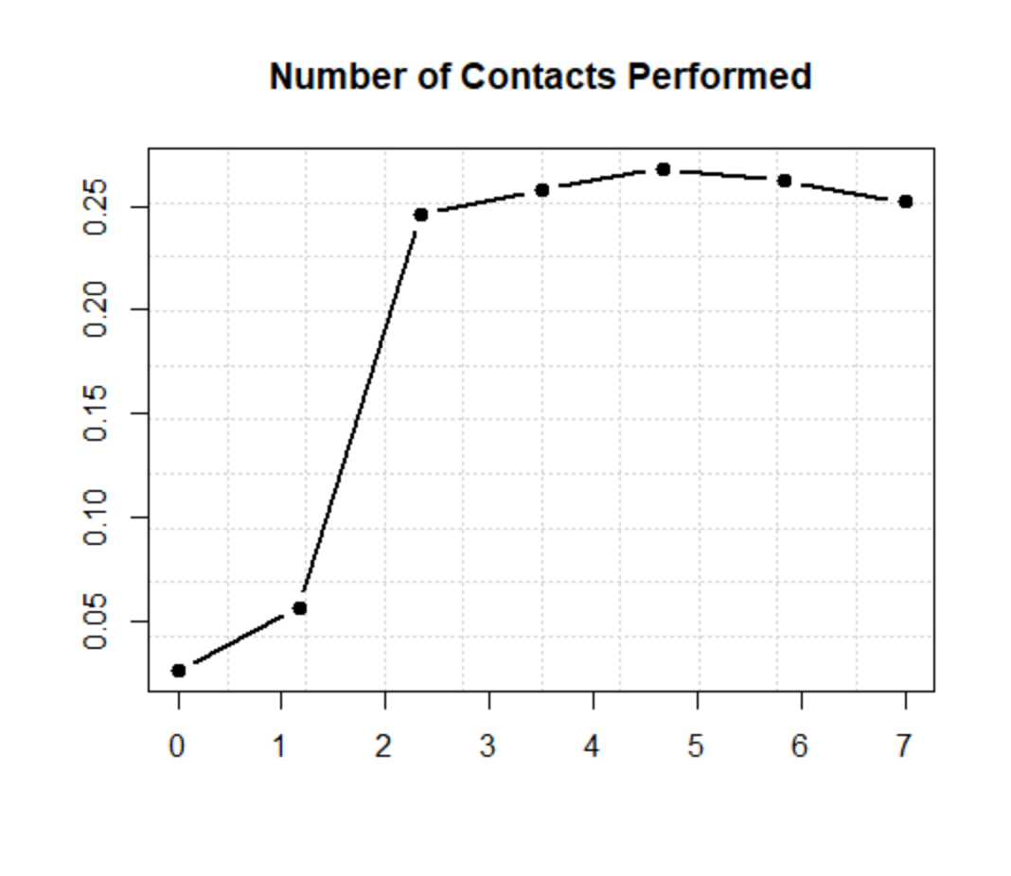
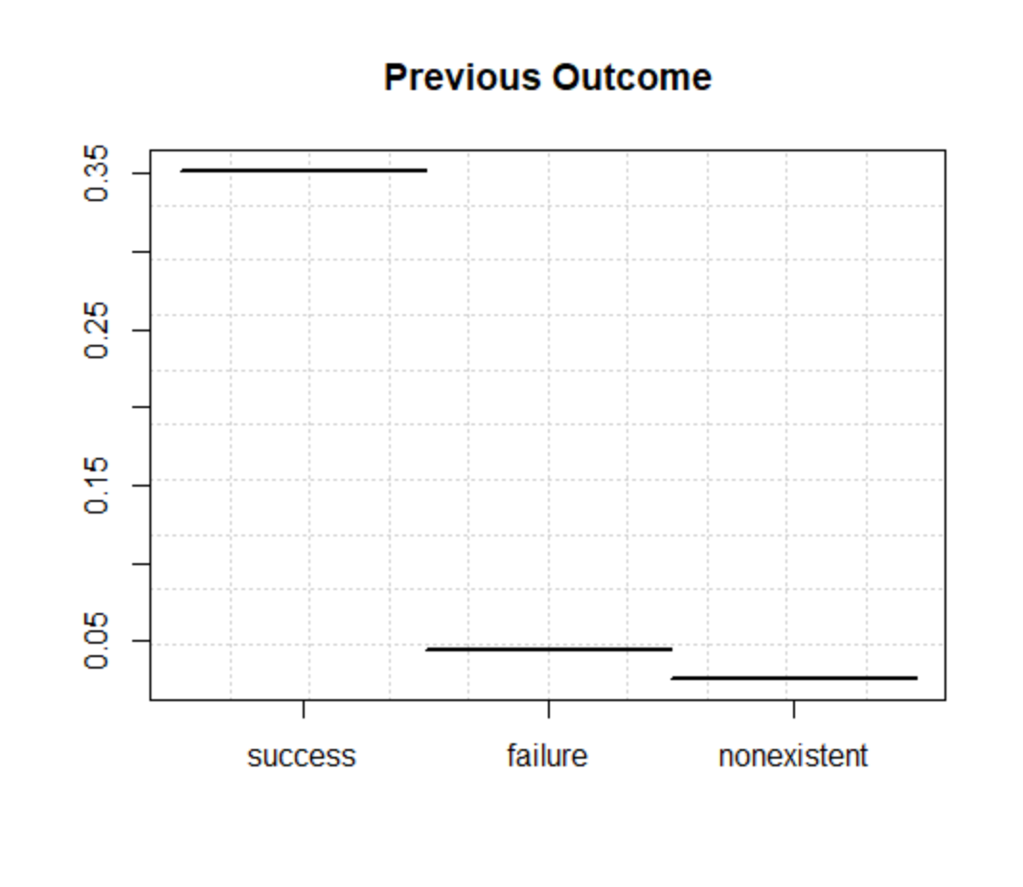
Sensitivity Analysis:

Slide 18
Q&A

